Slide 1
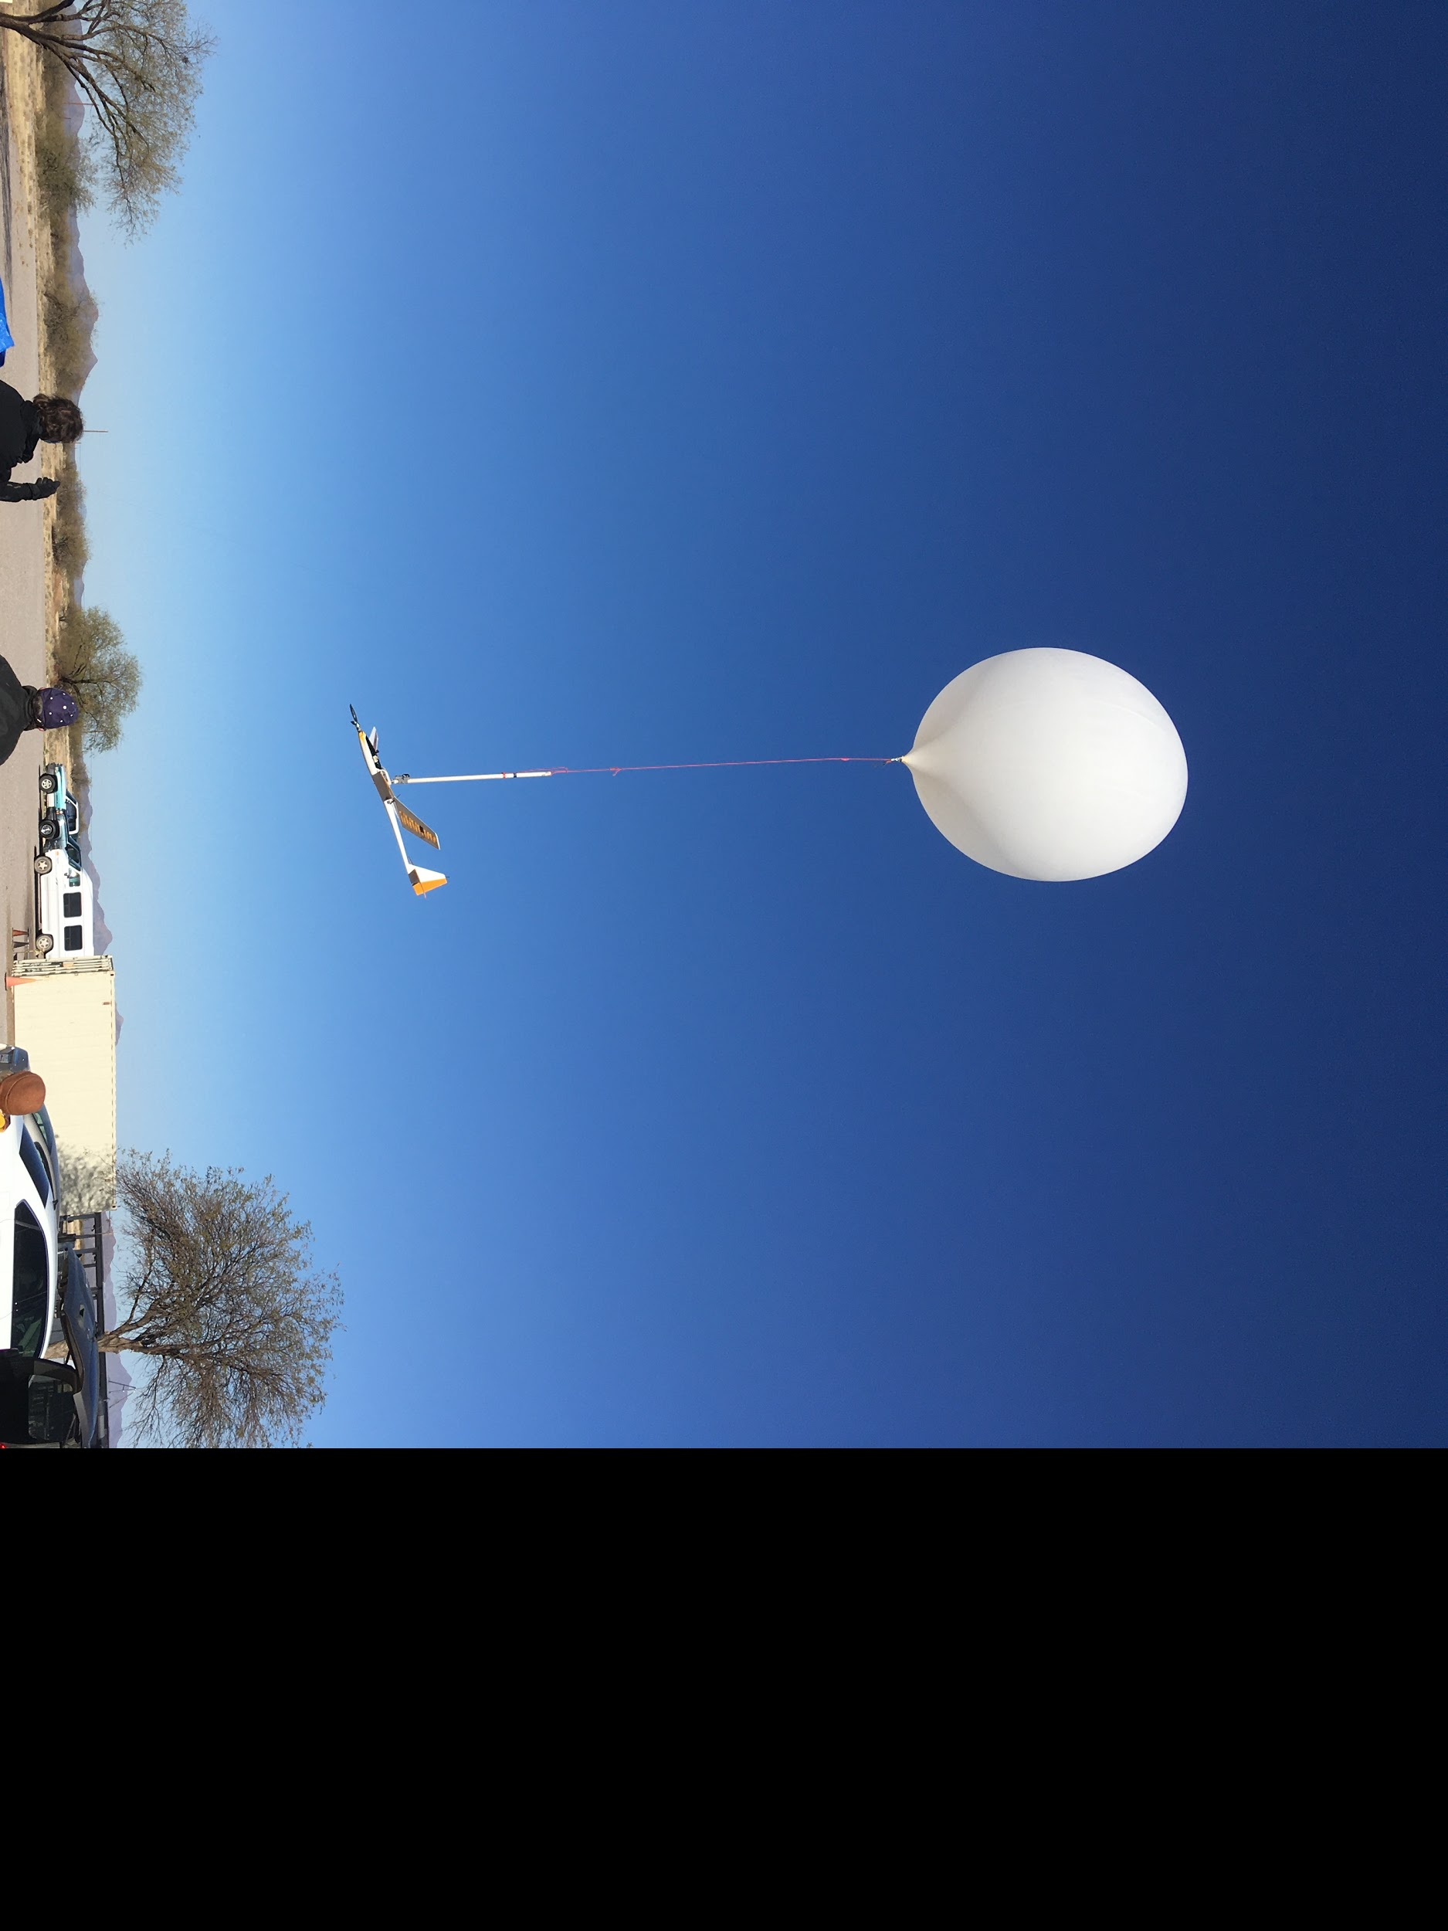




SUBORBITAL CREWLESS AERIAL VEHICLES FOR EARTH SURVEILLANCE & MARS EXPLORATION
MADDIE SCHIFFLER & REED SPURLING
MENTOR: SERGEY SHKARAYEV
COLLABORATOR: ADRIEN BOUSKELA
SPACE GRANT SYMPOSIUM
APRIL 17, 2021

Slide 2
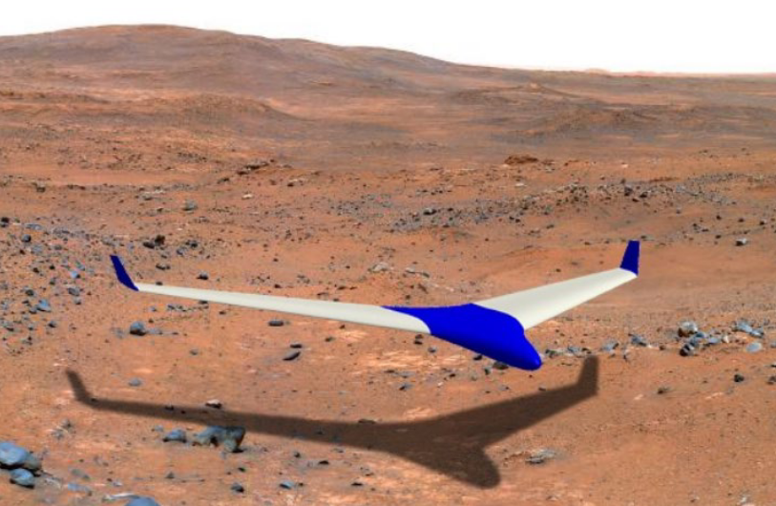
PROJECT GOAL: SAILPLANES FOR MARS
Sailplanes, imitating albatrosses, can theoretically fly for days without landing
Dynamic soaring
High-altitude flight on Earth
Mapping
Climatology
Telecommunications
Low-altitude and mid-altitude flight on Mars
Imaging interesting geology in rugged highlands
Canyon exploration
Close-up investigations of crater interiors
Higher pixel-scale image resolution than orbiters
More mobility than landers or rovers
Image credit: Parisa Footohi
Notes:
Backup slides:
ConOps diagram
Dynamic soaring

Slide 3
WHAT WE’VE BEEN DOING THIS YEAR
To develop, assemble, and test a weather balloon-based system to support experimental flights of a prototype sailplane at altitudes up to 100,000 feet above Earth’s surface, where the atmosphere is similar to Mars’ atmosphere.
Thus far, we have launched this system twice, once without our sailplane—to verify the accuracy of our calculations and the proper functioning of electronics and telemetry systems—and once with the sailplane to test the preparedness of our ground station and balloon release mechanism

Slide 4
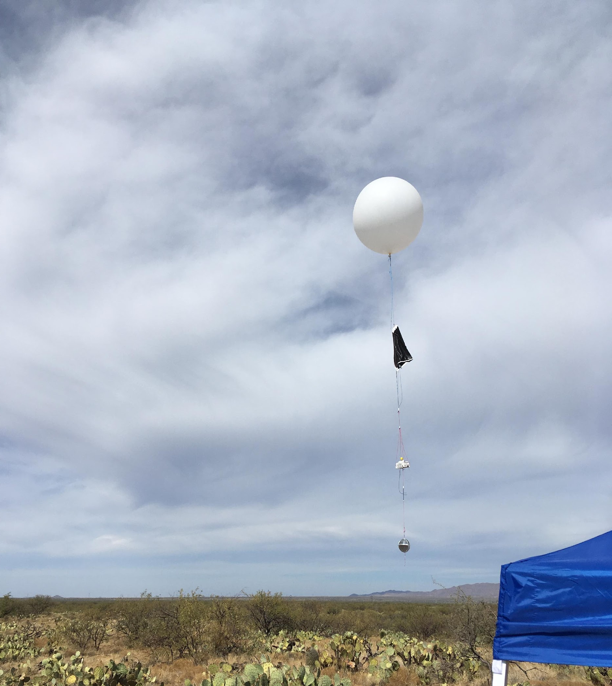
FIRST TEST FLIGHT (NO SAILPLANE)
Goals:
Balloon helium lift calculation and launch procedure verification
Wind measurement system tests
Preliminary ground system tests

Slide 5
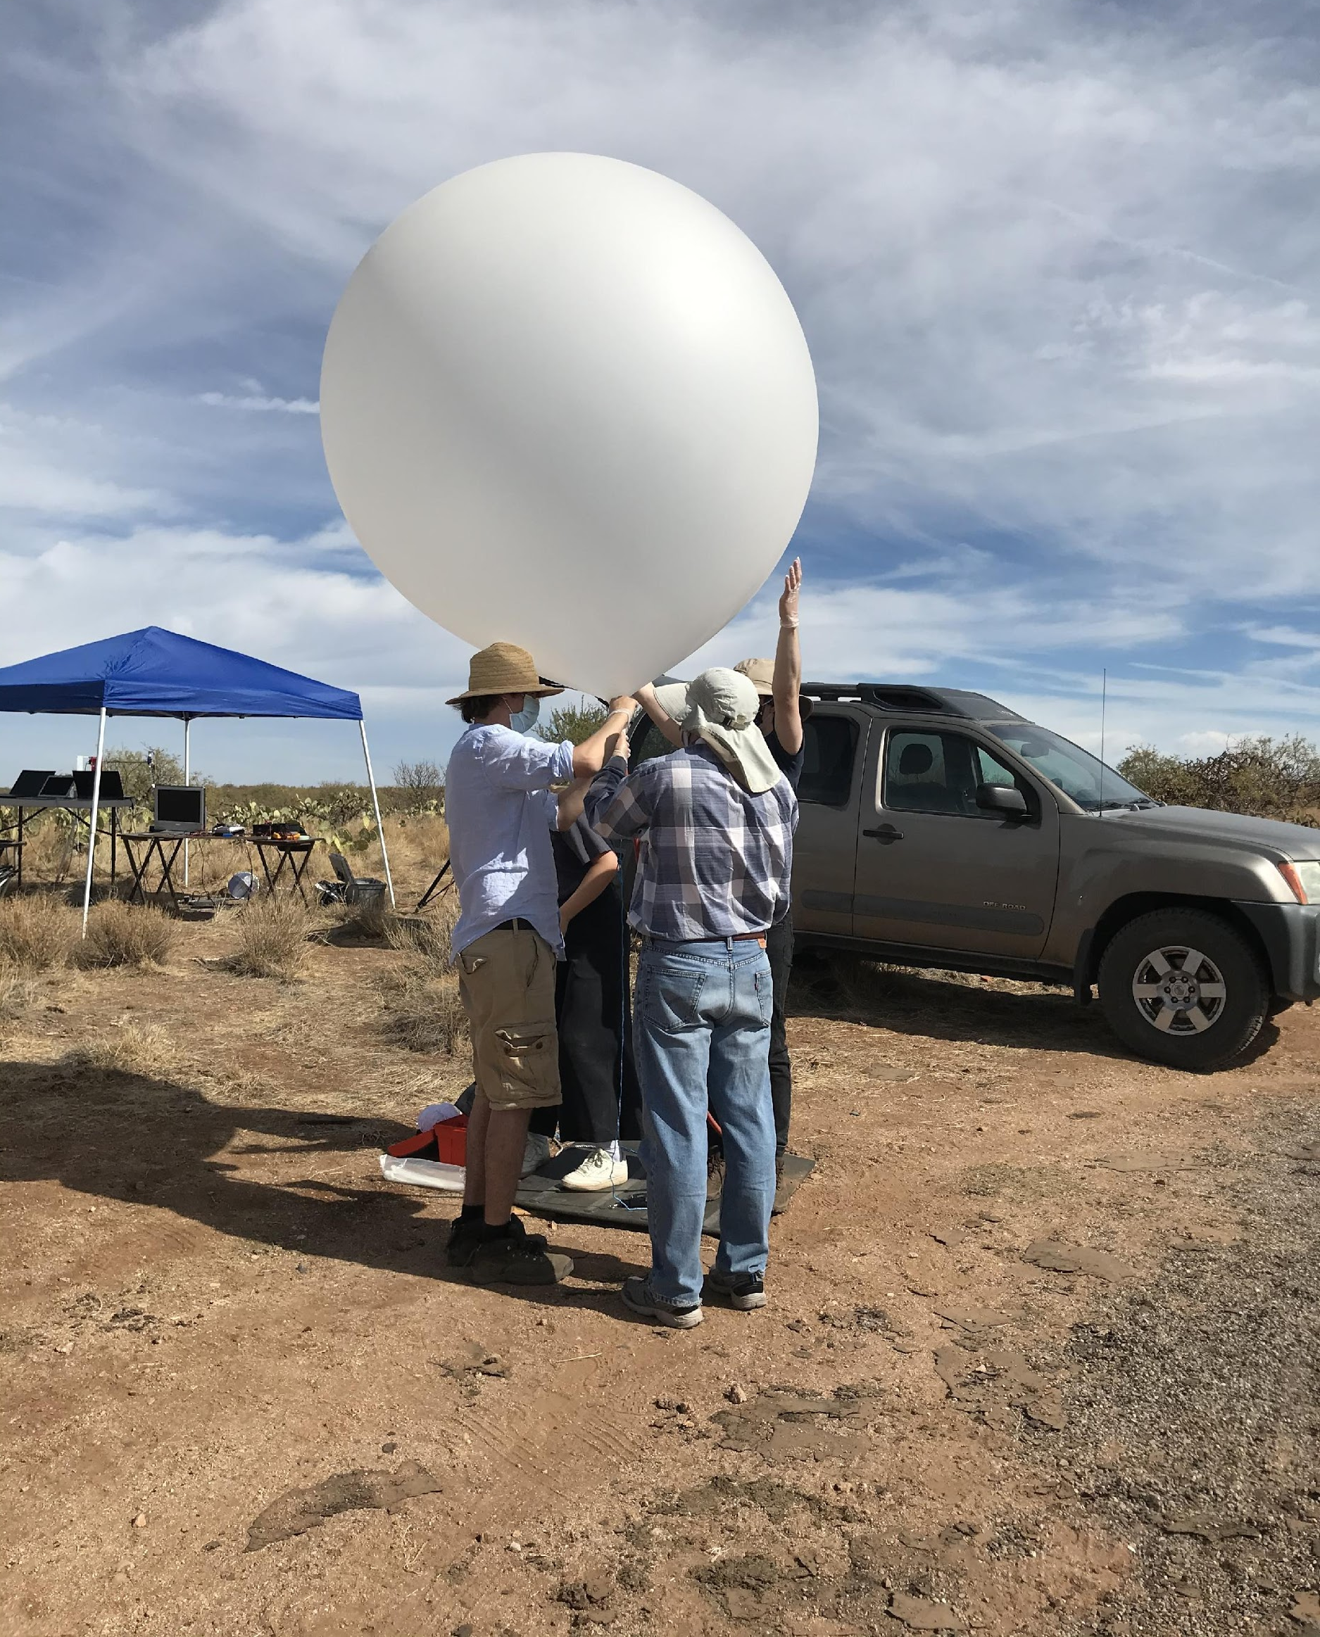
INFLATING + RELEASING
Discovered that we need a system to make filling and releasing the balloon easier
Helium calculations were accurate, bringing the payload up to altitude at a rate of 5 m/s

Slide 6
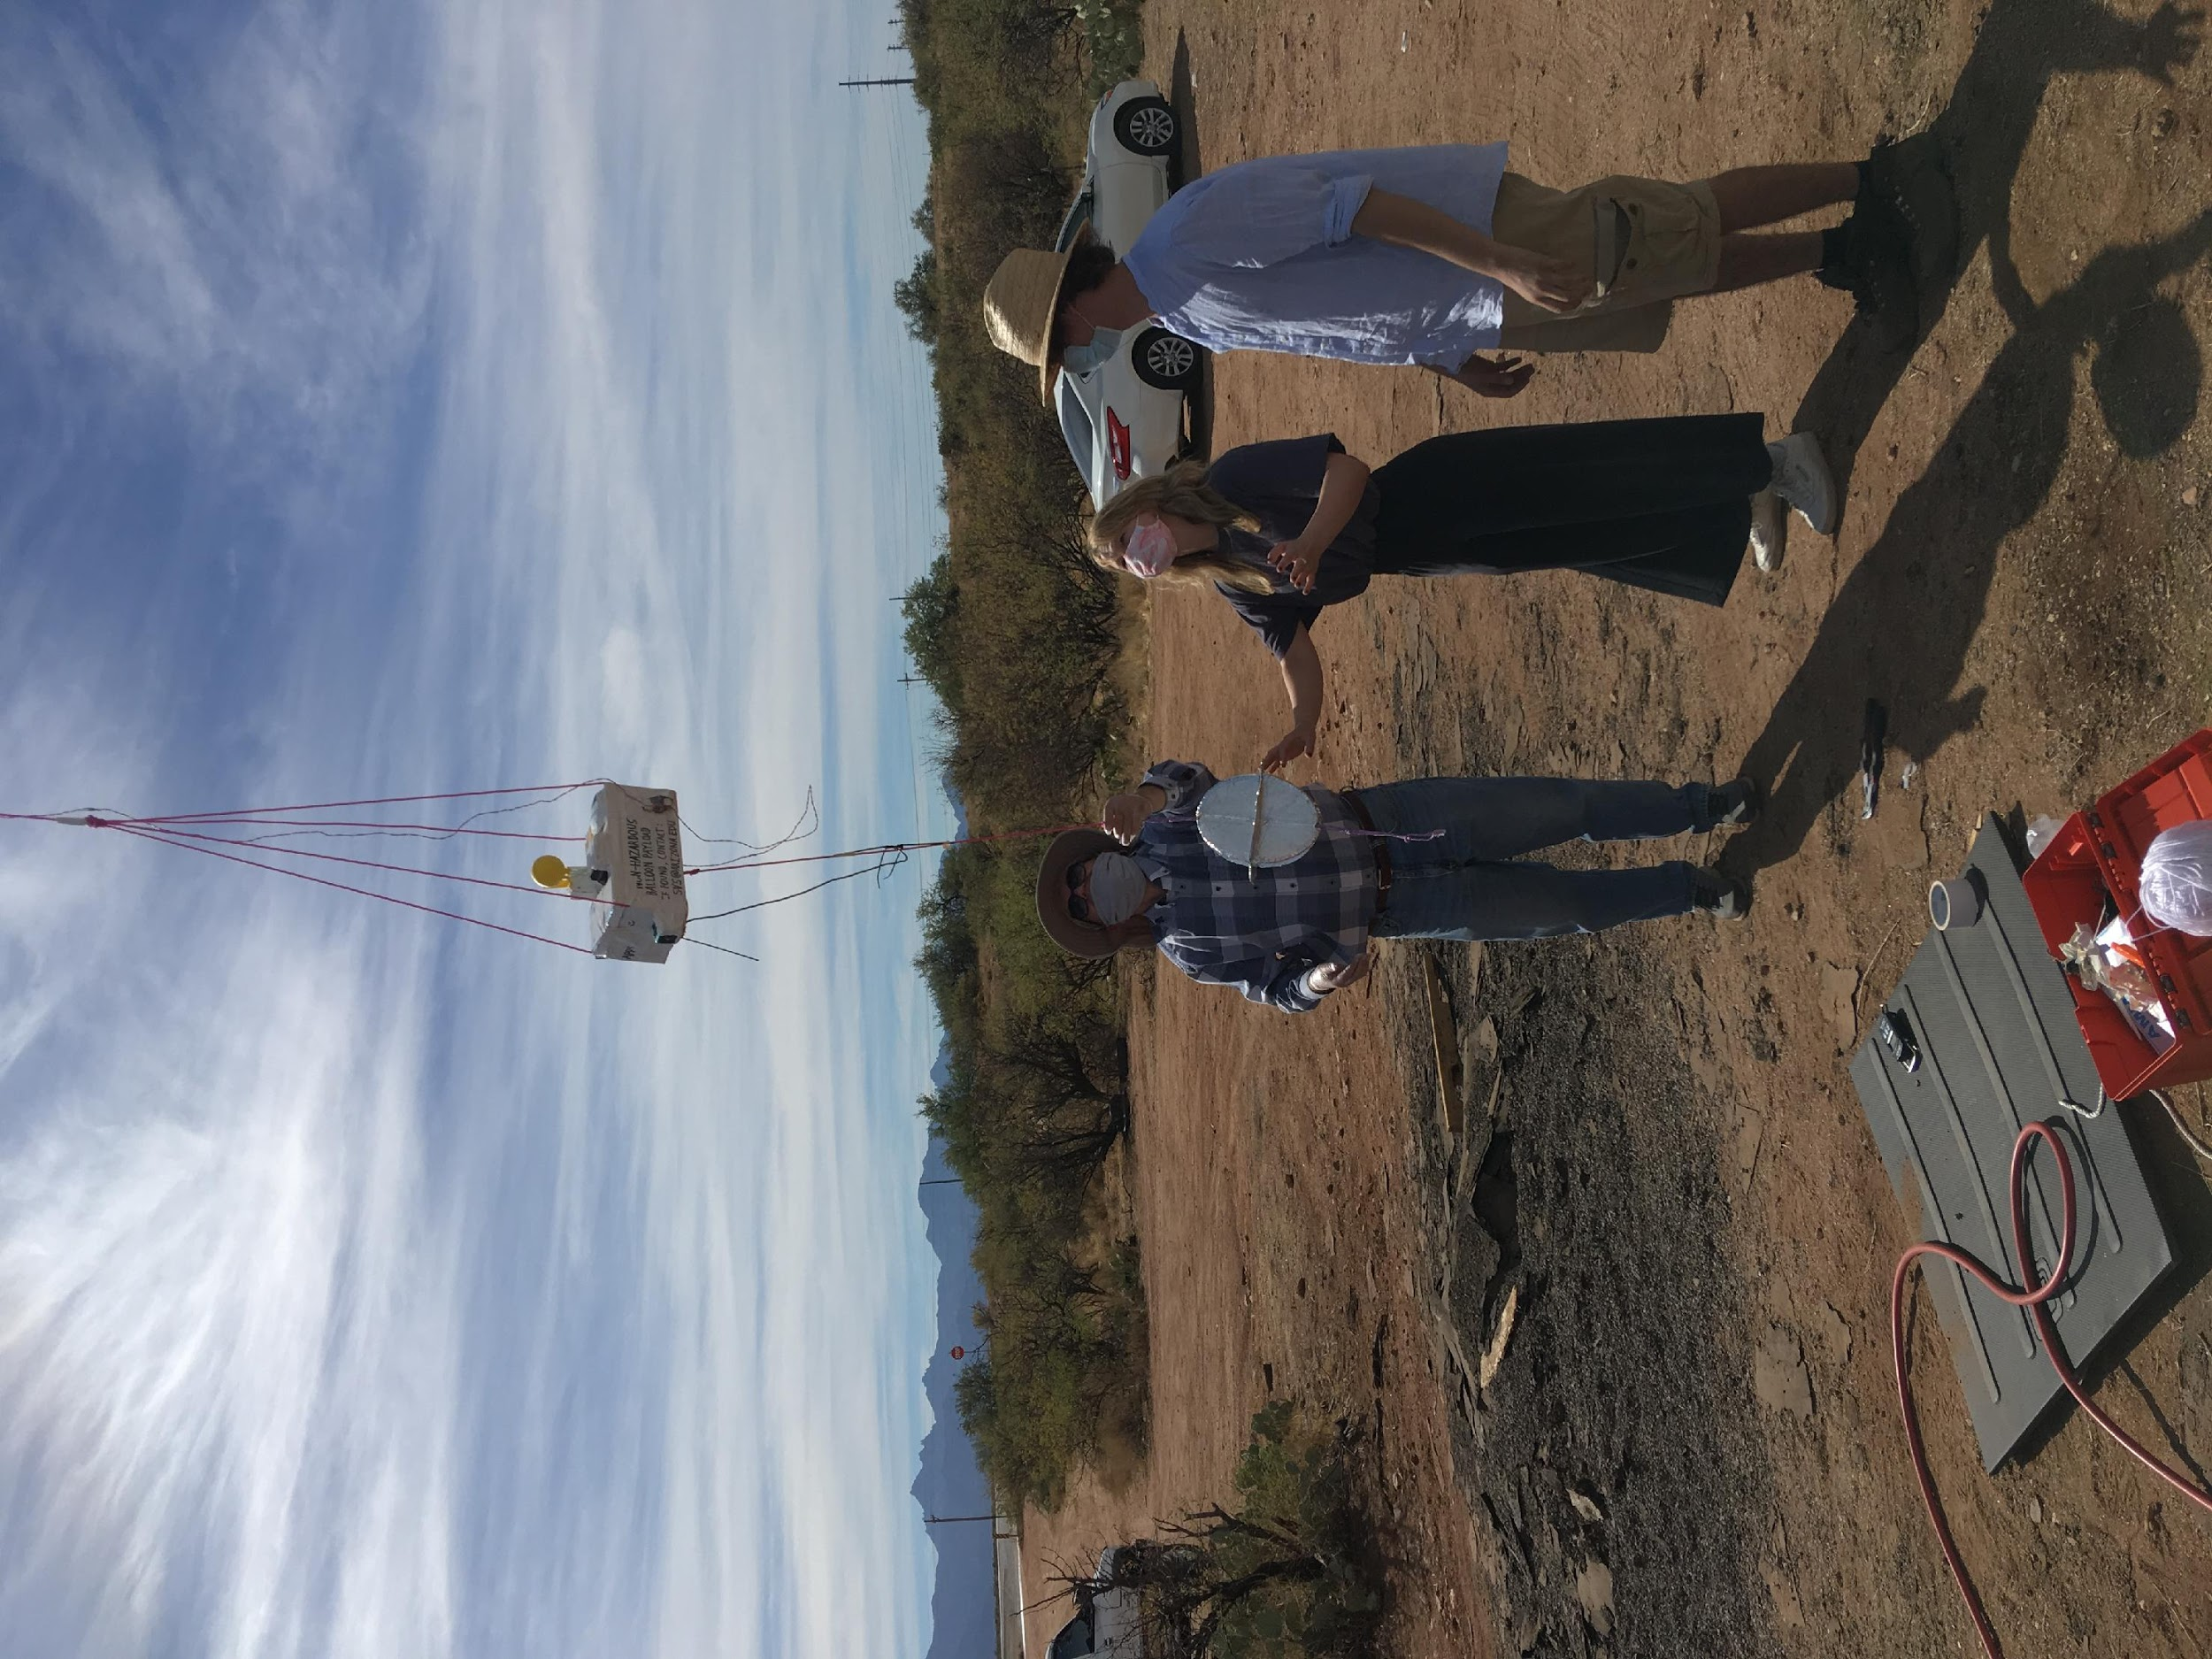
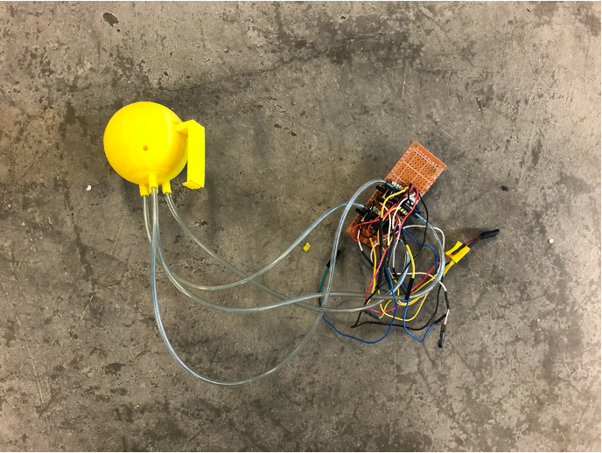
WIND MEASUREMENTS
In order to study the wind shears and gusts that enable dynamic soaring, we need accurate measurements
We 3D printed a multi-directional pressure sensor for this flight test
Ended up with a lot of inaccuracies in the data and concluded that a new system needs to be developed

Slide 7
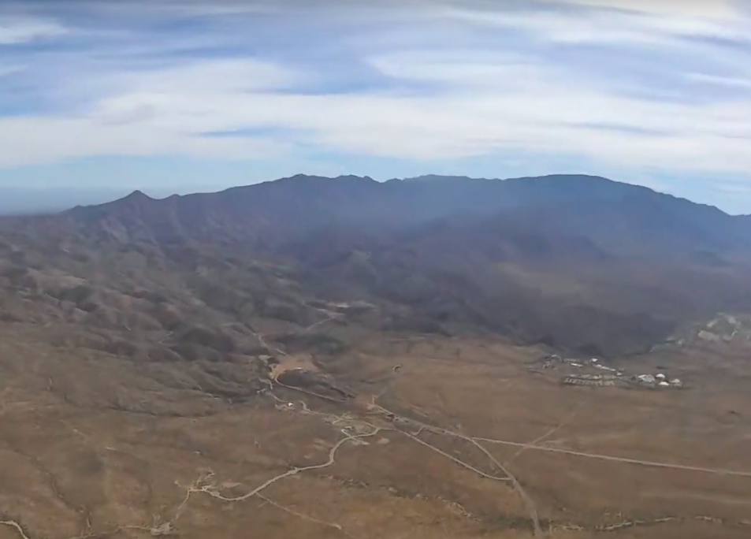
GROUND SYSTEM TESTS
The ground system code worked
Live telemetry from the balloon payload
The hardware took a long time to set up
The antennas did not automatically point in the right direction
Next steps
Redesign antenna pointing hardware
Improve ease of assembly and use
Improve code
Readability
Autonomy

Slide 8
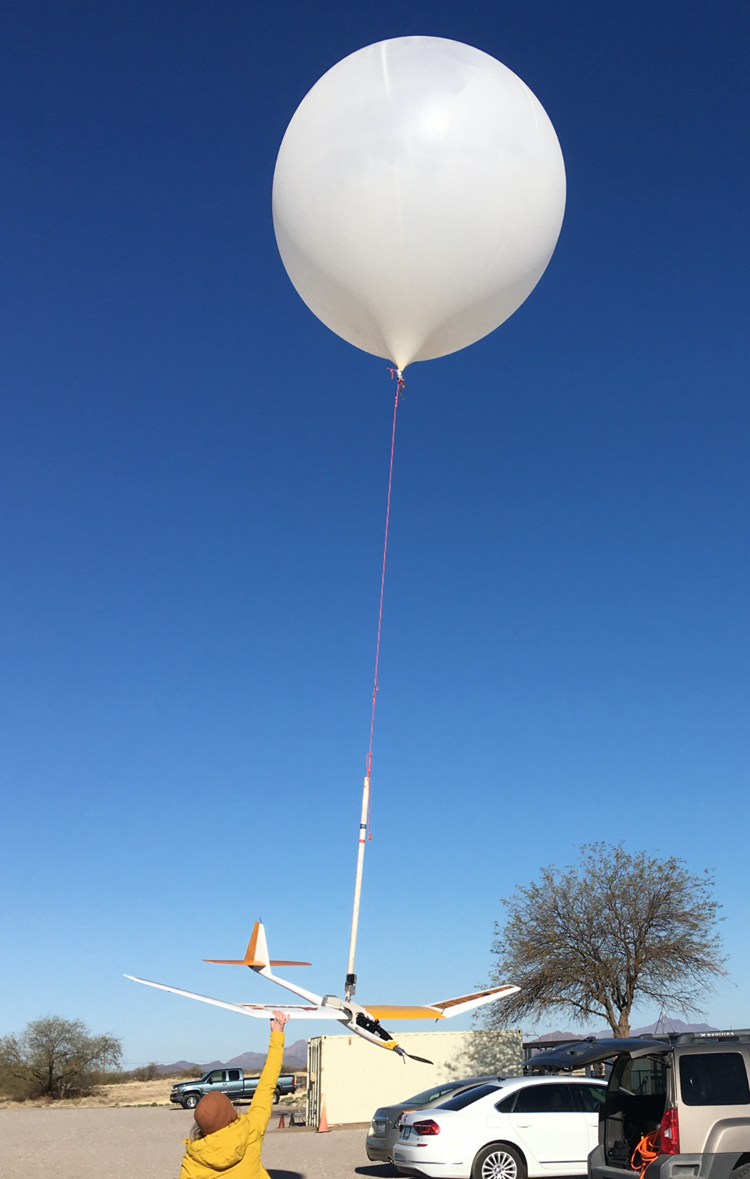
SECOND FLIGHT TEST (TETHERED)
Testing goals:
Ground system operation
Telemetry connection/ground station capabilities
Balloon housing aptitude
Release mechanism capability & optimal release pitch angle

Slide 9
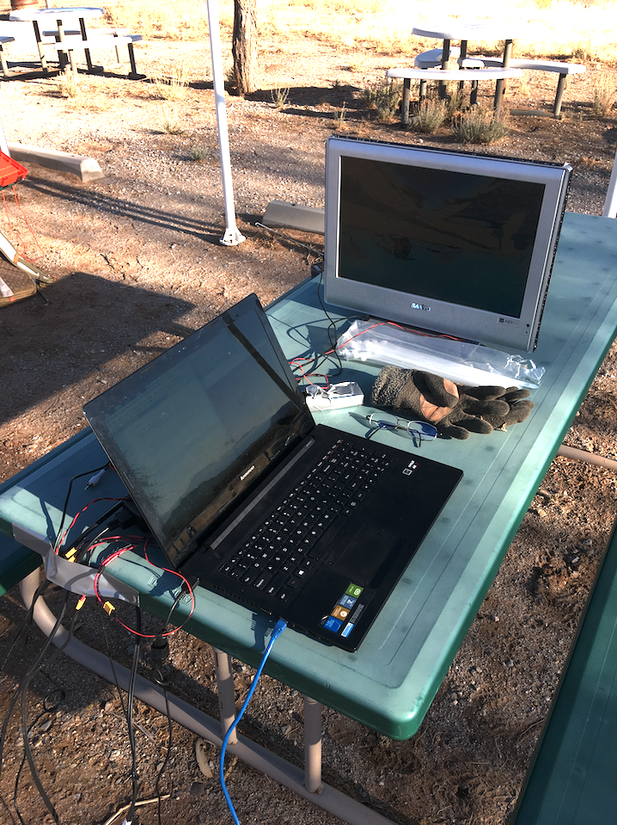
GROUND STATION
Video Display
First-person view (FPV) available
Sailplane can be directly controlled from one or many laptops
Still too complicated
Setup should ideally take just a few minutes

Slide 10
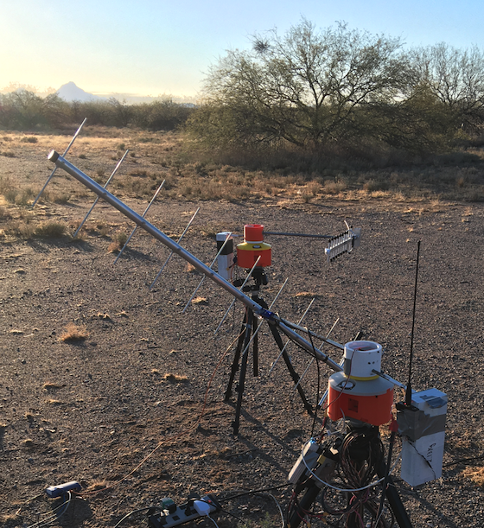
IMPROVED ANTENNA SYSTEM
Two antennas
Video receiver
Telemetry receiver and controller
3D-printed enclosure
Off-the-shelf components
Camera tripods
Raspberry Pi computers
Compass/GPS modules
Wiring
Inexpensive!
Notes:
maybe add in more CAD models

Slide 11
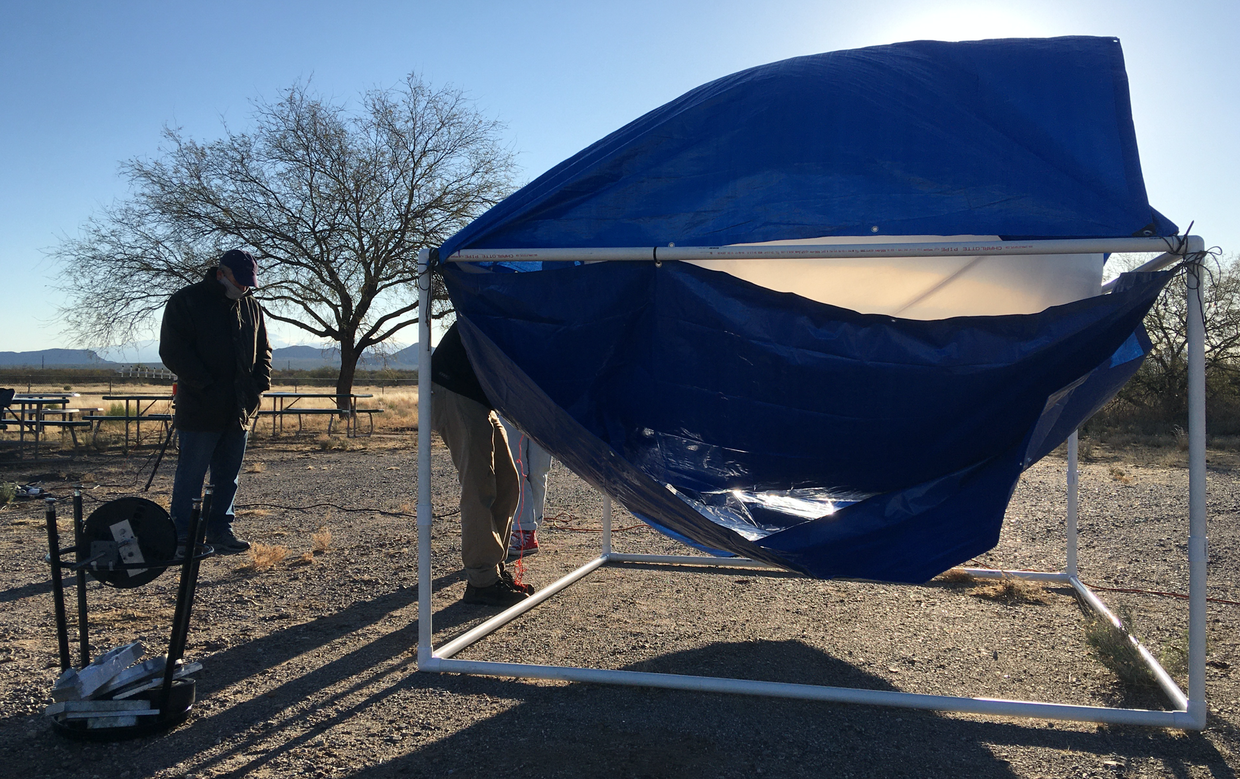
BALLOON HOUSING
Made inflating and releasing the balloon easier

Slide 12
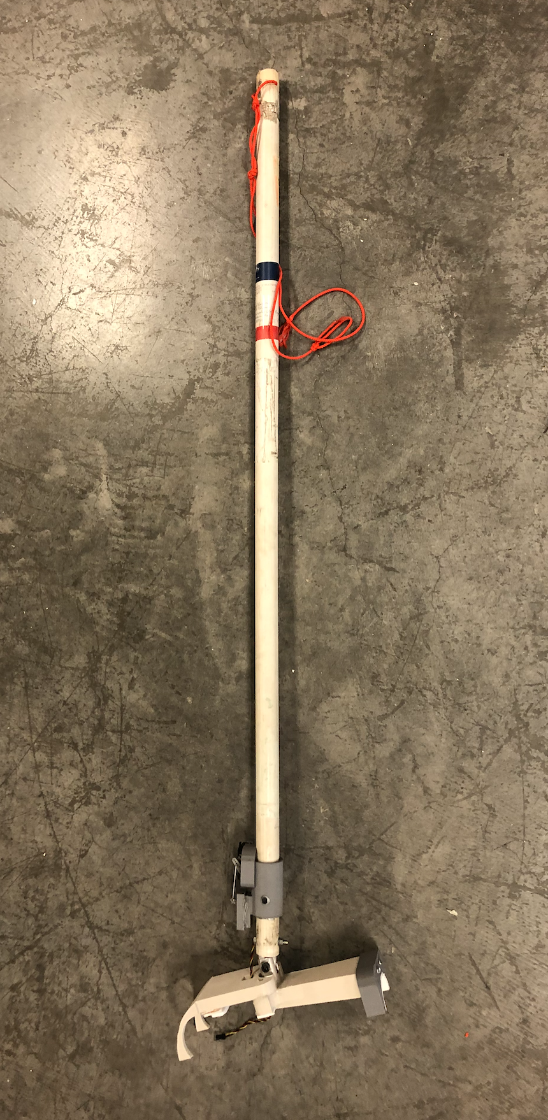
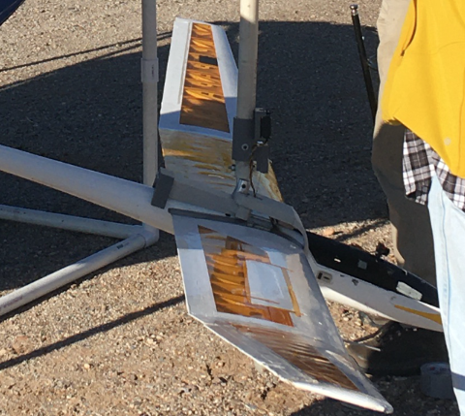
RELEASE MECHANISM
Necessary for safe and reliable separation of the sailplane from the balloon
Many iterations made before landing on this design, positioned at the center of gravity and fits around the plane shape
Notes:
add picture

Slide 13
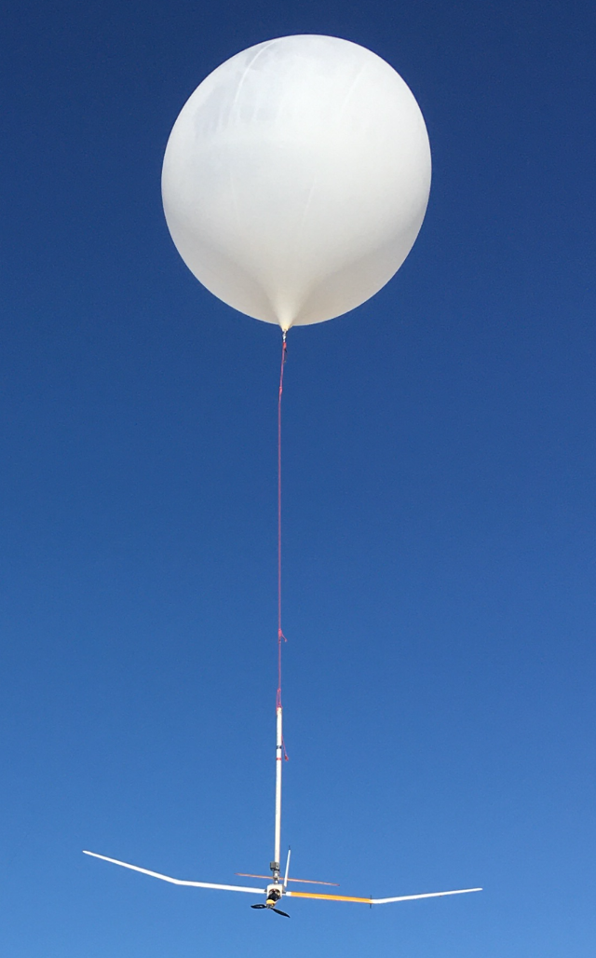
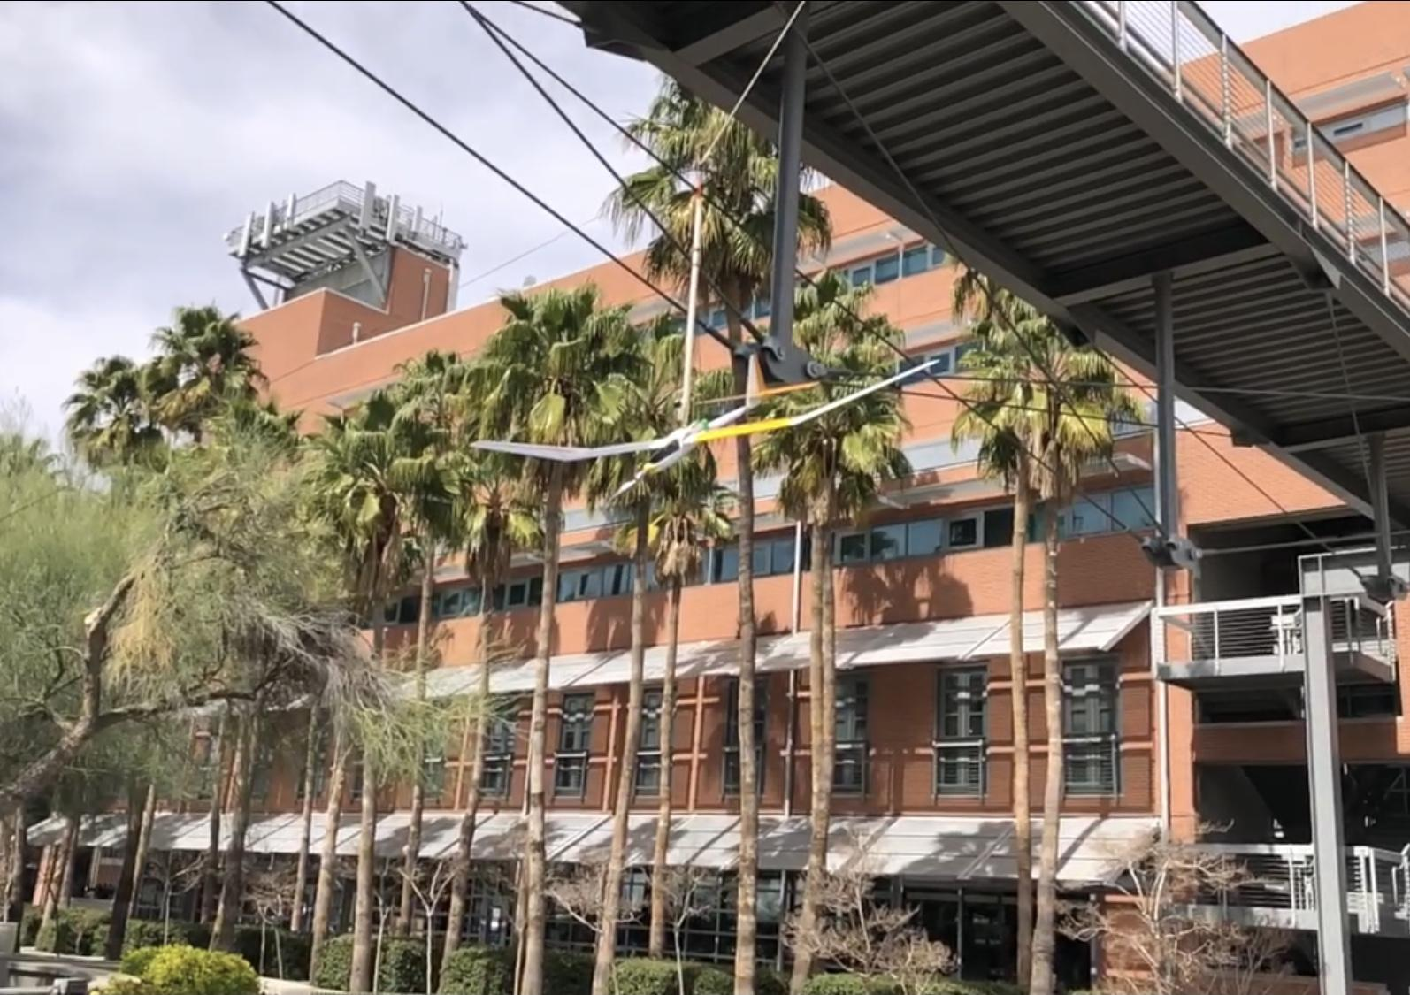
OPTIMAL PITCH ANGLE
Pitch angle is the angle at which the plane is oriented: pitch up - nose up, pitch down - nose down
Pitched down works best with release mechanism
Flight mode recovers best with this pitch angle of approximately -30°

Slide 14
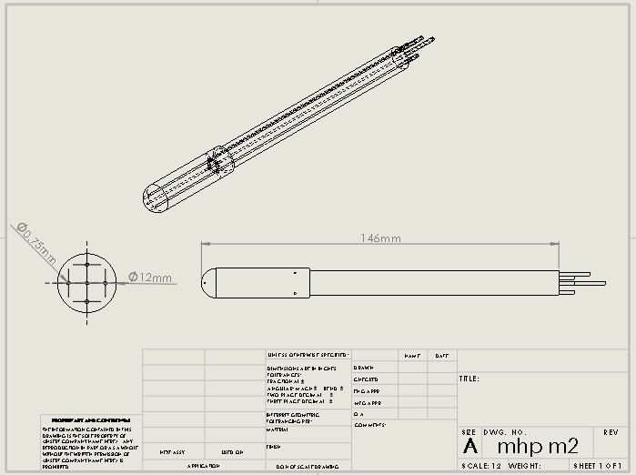
WHAT MADDIE WILL BE WORKING ON
Continue work on the release system as necessary
Multi-hole probe pressure sensor for wind measurements + testing
Based on research done by students at Oklahoma State University, Stillwater, OK

Slide 15
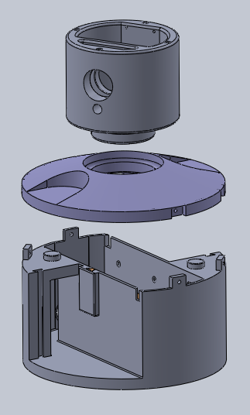
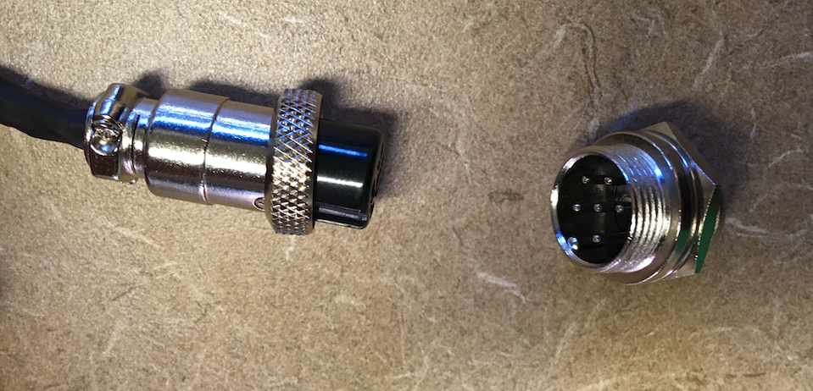
WHAT REED WILL BE WORKING ON
Further improved antenna pointing system design
Modular design to enable easy component swaps
Press-fit assembly with fewer bolts
Better electrical connections
Fully automated

Slide 16
THANK YOU!
Sailplanes and dynamic soaring methods expand the possibilities for planetary exploration!
We are continuing to develop this technology and plan to demonstrate its feasibility in upcoming high-altitude flight tests.
Professor Sergey Shkarayev
Adrien Bouskela
Arizona Space Grant Consortium
Aerospace and Mechanical Engineering Department

